Slide 1
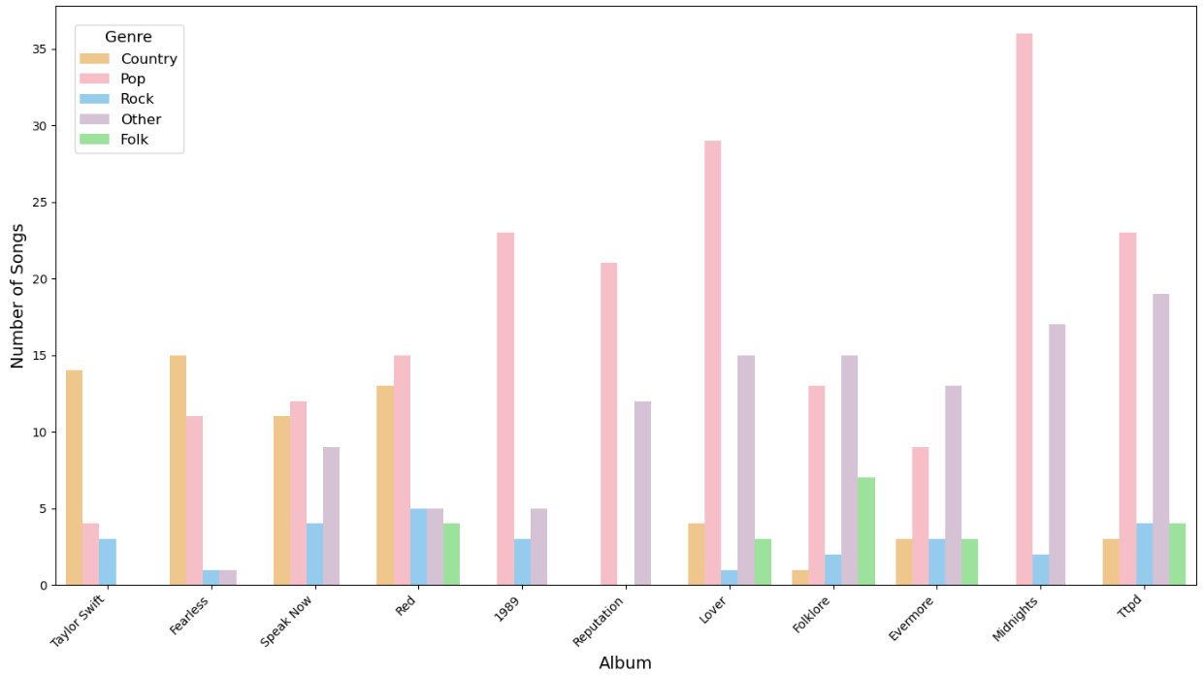
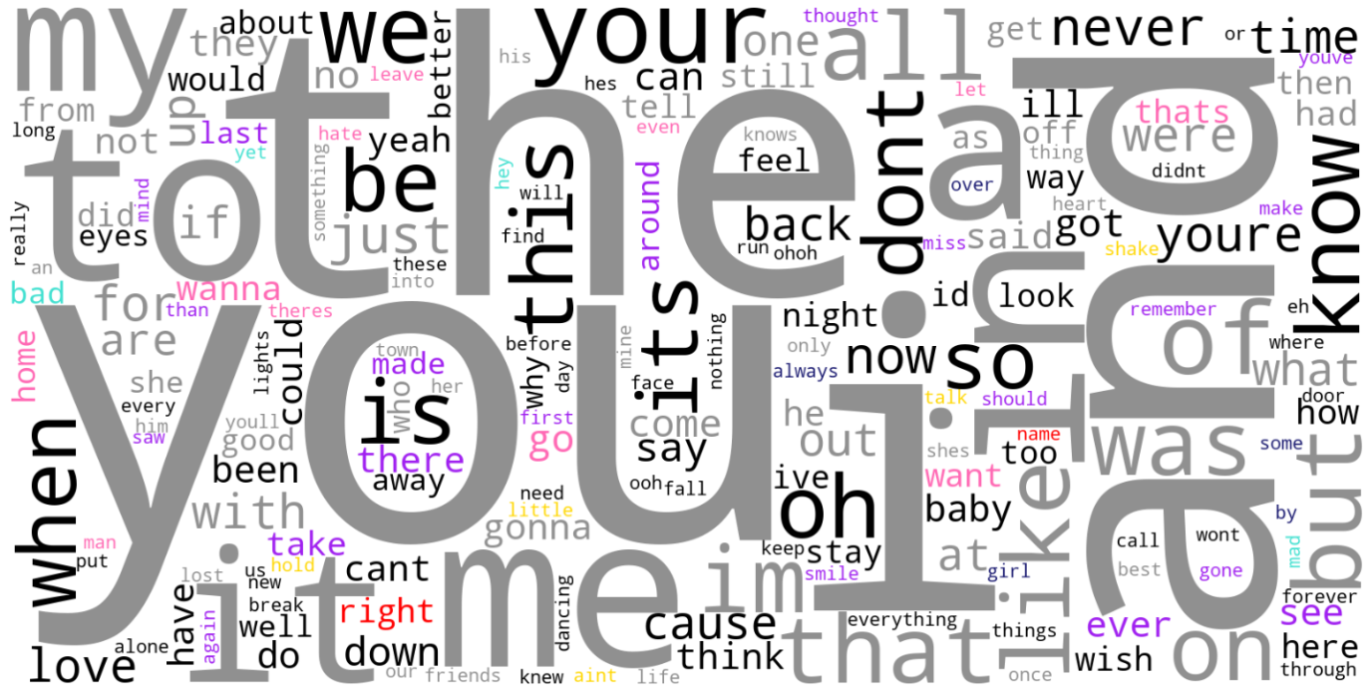
Mapping Taylor Swift: Visualizing Genre Evolution, Word Themes, and Tour Geography
By: Jenny Wang

Slide 2
